Slide 1

Do You Really Know the NBA?
Jim Tran
George Redak
Sharifah Sinclair
Vena Li
Jim Tran
George Redak
Sharifah Sinclair
Vena Li

Slide 2
Project Introduction
The NBA is full of interesting statistics and data available for data analysis. We picked this topic as basketball fans and as sports fans in general who want to try and make sense of the data and its impact on the game.
We looked at how game statistics impact the game; specifically, which player positions is most valuable; what traditional and advanced statistics by players and by teams is more meaningful; as well as a look at player salaries through the decades.
Notes:
Define the core message or hypothesis of your project.
Describe the questions you asked, and why you asked them
Describe whether you were able to answer these questions to your satisfaction, and briefly summarize your findings

Slide 3
Proposal💡
🏀 Most Valuable Position on the Court
🏀 Most Important Traditional Stat
🏀 Playoffs Performances
🏀 Most Important Advanced Stat
🏀 Salary
🏀 Height, Age and Weight
Notes:
24sec
We extracted data from Dataworld, Kaggle and NBA API calls to answer the questions. First, we looked at the data for the most valuable positions. For this we took the mean of the winning shares for the five common positions (point guard, shooting guard, small forward, power forward, center) for players from 1978 to 2015. Next, we compared the traditional statistics such as points, assists, field goals and rebounds to team wins from 2014 to 2018. Team points and team wins were extracted from 2 different sources and merged into one dataframe for analysis and graphing. We then looked at advanced statistics such as Tm, PER, BPM, VORP, WS, Team Mar by players and from 1985 onwards was extracted and transformed for analysis and graphing. Additionally, player’s average salaries over the years from 1991 to 2018 was extracted and calculated and graphed.
(what kind of data do we need for each questions)

Slide 4
Data Cleanup & Exploration
We were able to extract data from different sources such as Dataworld, Kaggle, NBA API and NBAStats.net
The data was abundance and was initially tedious to go through all the datasets to find the ones that was best suited for our analysis. Some of the data cleansing include converting data types from integer to object, from null to 0 values for summing, consolidating wins only, changing the seasons formats from (YYYY-MM) to YYYY, filter stats by specific stat or year, and replacing team abbreviations for consistency.
With the NBA API, it was difficult to get a loop going to get the players that we wanted. We had to call each player individually, and then find the stats that we wanted to create the desired data frame. A loop would’ve been helpful here, but because the NBA API is a built-in python package, we had some difficulty with the creation of the loop.
Notes:
Extract: Dataworld, Kaggle, NBA API and NBAStats.net
Cleanup:
abundance and was initially tedious
converting data types
changing the seasons formats
Exploration:
Difficult Loop in NBA API

Slide 5
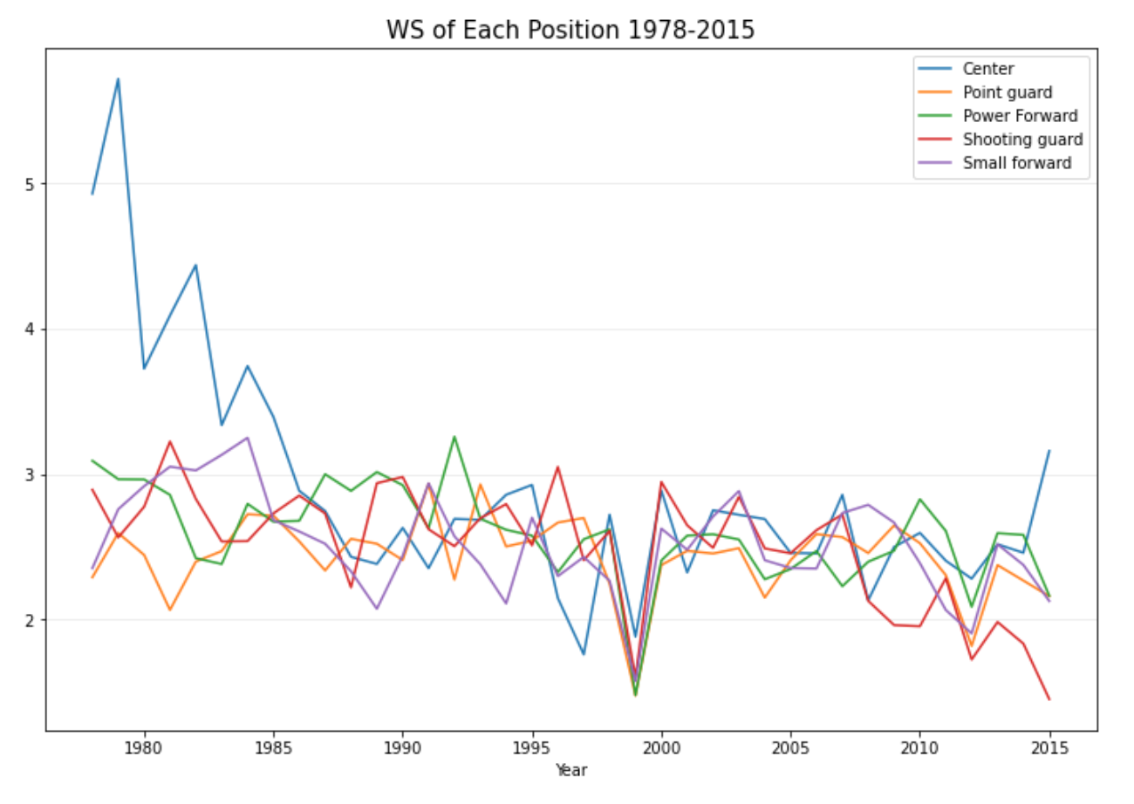
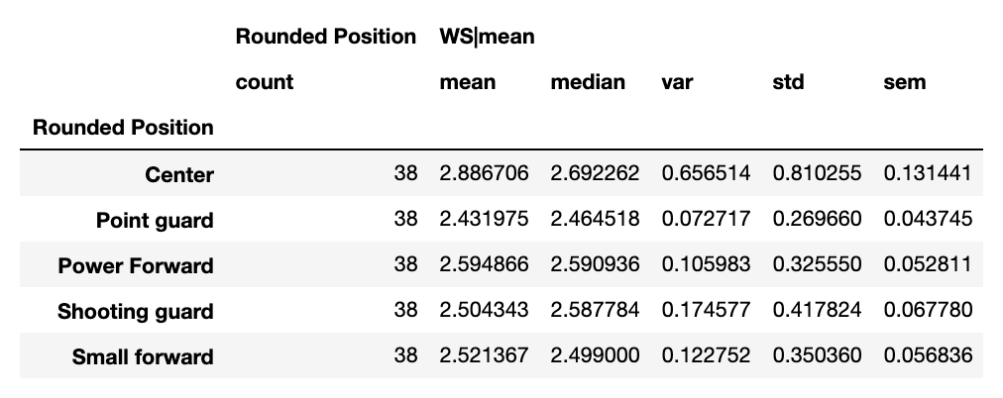
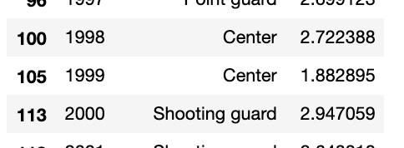
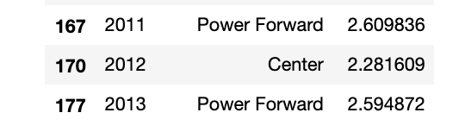
Most Valuable Position on the Court
Generate data from 1978 to 2015
Try to find out which position is most valuable in each year and try to see if there is a specific trend.
“Center” is the most valuable position during 1978-1986
“Center” is also the most valuable position in general
1999, 2012 seasons are shorter due to salary negotiation
Notes:
2’10

Slide 6
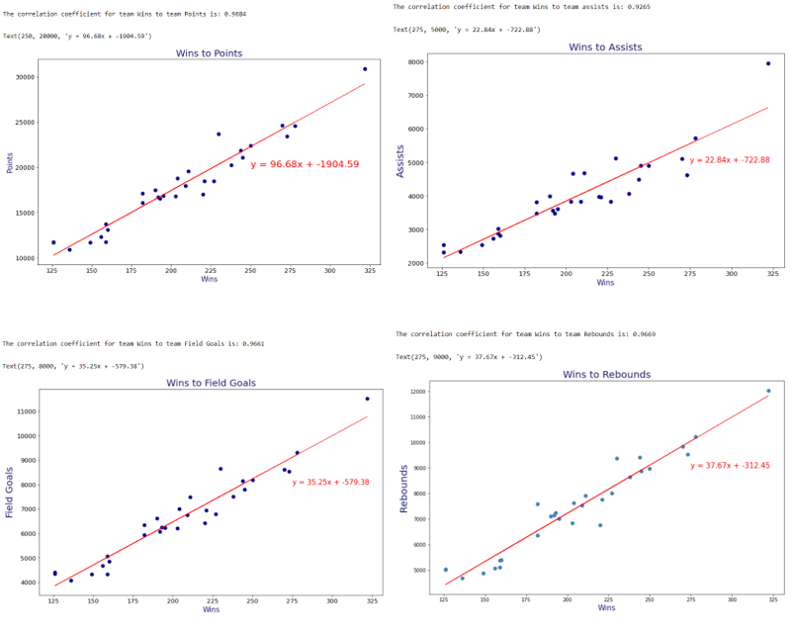
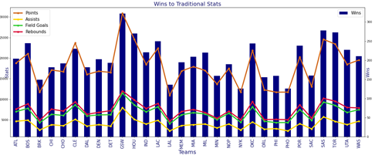
Most Important Traditional Stats
Extracted separate datasets for team points and for team wins
Merged by year and team abbreviations for a complete dataframe made up of Teams Wins, Points, Assists, Field Goals and Rebounds.
Graph each stat against each team’s wins
The correlation is approximately 0.96 which suggests a strong positive relationship between wins and each of the stats.
Multi line and bar graph show game stats trend with team wins.
With the given data, not one stat is more important than the other.
Notes:
3’06

Slide 7
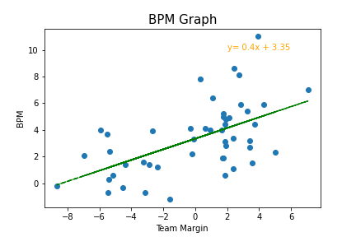
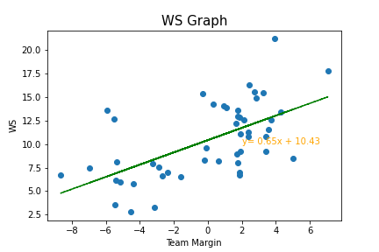
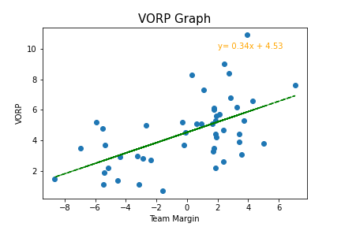
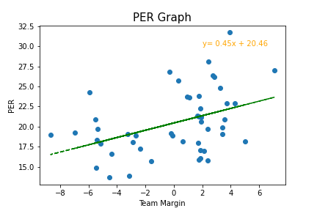
Most Important Advanced Stat
Picked the following 4 advanced metrics: PER, BPM, WS, and VORP
Looked at the correlation between individual players with over 3300 minutes who played after 1985 (no such stats can be calculated for before 1985) and Team Margin (Difference of points scored and points allowed). No r-value exceeded 0.6.
CONCLUSION: Individual player performance has a minimal effect on the outcome of games. Even if you filter to only see the best players.
Notes:
Finish time: 4’21

Slide 8
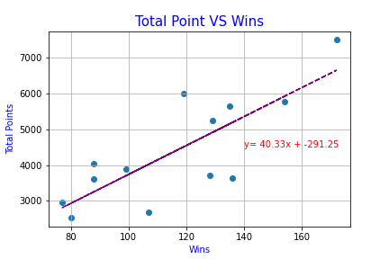
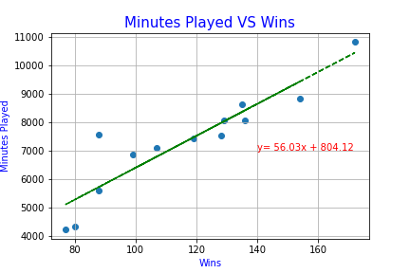
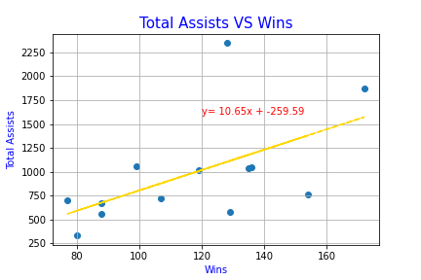
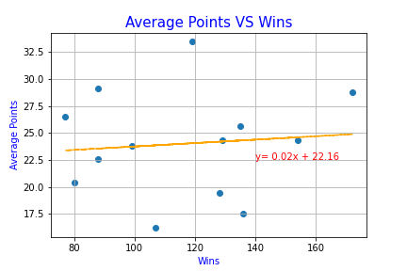
Playoff
Picked the top 13 playoff players ever and looked at their stats (subjective, but most will agree to this list)
Tried to find correlation between major stats and playoff wins.
Minutes Played (Total) and Total Points were the biggest indicators of a high playoff win total.
Individual game performances (avg. points, avg. rebounds, etc.) do not correlate to winning playoff games.
Players studied: Wilt Chamberlain, Bill Russell, Kareem A. Jabbar, Larry Bird, Magic Johnson, Michael Jordan, Scottie Pippen, Kobe Bryant, LeBron James, Steph Curry, Kevin Durant, Kawhi Leonard
Notes:
Finish time: 5’51

Slide 9
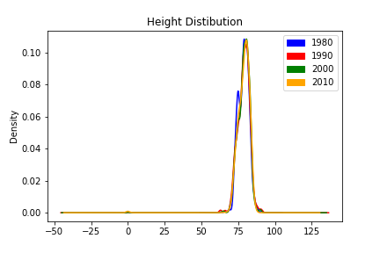
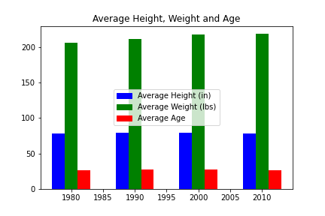
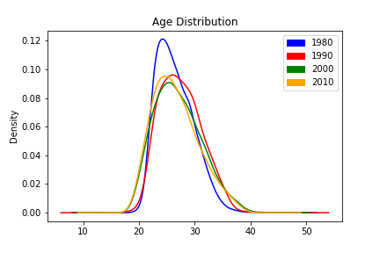
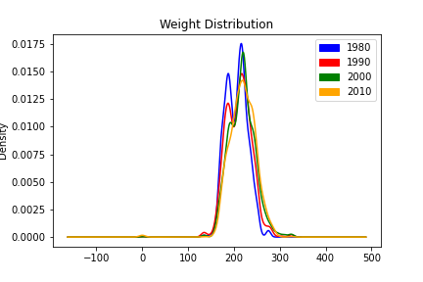
Fun Facts About the NBA
What era is the heaviest?
What era is the tallest?
Very interesting to see that the average age, weight and height has been steady.
Biggest change seen in average weight, a 15 lbs difference between 1980s and 2010s.
Age distribution in the 1980’s shows a bigger share of 20 year olds than any other era.
Notes:
Finish time: 6’28

Slide 10
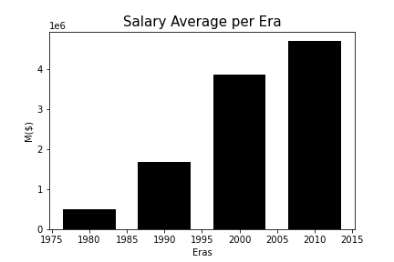
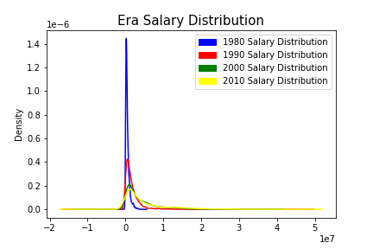
How have salaries evolved?
Based on the salary distribution, the most noticeable trend can be seen in the way money is spread throughout the league. In the 1980’s, most salaries were almost all the same, and slowly, over time, player’s salaries evolved into what they are today, with player’s making money based on their effectiveness on the court.
Notes:
6’55

Slide 11
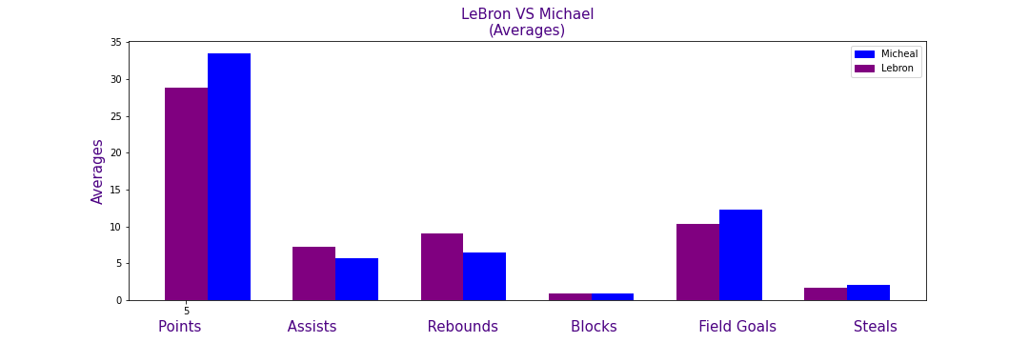
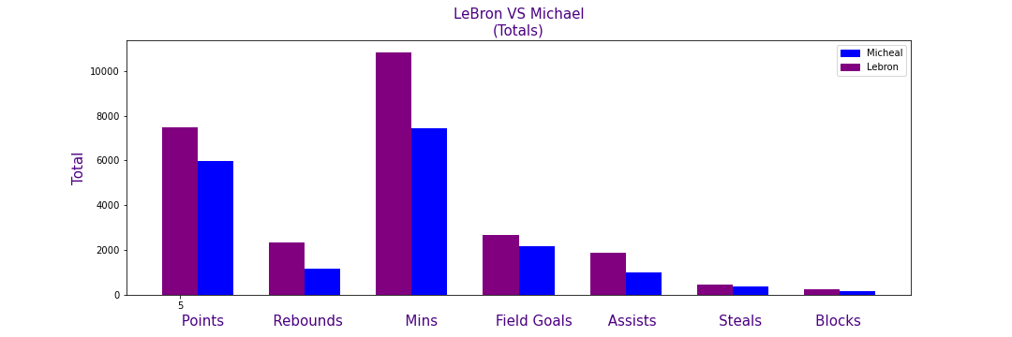
LeBron James VS
Michael Jordan
Notes:
Finish time: 7’45

Slide 12
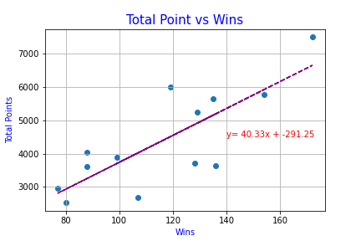
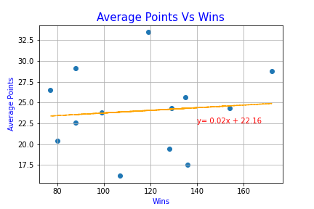
Discussion
The biggest take away from this analysis is the lack of evidence to support that great statistical achievements from individuals creates a winning team.
Per Game individual averages (advance or traditional) almost have no correlation to the team winning, in the playoffs or otherwise
Totals is the biggest indicator of a player’s ability to win.
Notes:
Finish time: 8’15

Slide 13
Post Mortem
One issue was navigating the NBA API. Calling players by their id was the only way to get data, and this was a tedious process
Finding data specific on the playoffs was very difficult. We created our own dataframe from NBA API for this.
The question of how important a player is to their team can be further explored by looking at data specific to lineup combinations. This would be a next step, looking specifically at players and positions when they are on the court vs. off the court.
Notes:
Finish time: 9‘15

Slide 14
Questions?

Slide 15


